Slide 1
Flip Flop Qubits
Maneesha Penkeesu
Sravya Jarugu
Akshay Mukkavilli
Sai Charan Reddy Kuntla

Slide 2
STRUCTURE
A silicon chip is covered with a layer of insulating silicon oxide, on top of which rests a pattern of metallic electrodes that operate at temperatures near absolute zero and in the presence of a very strong magnetic field.
At the core is a phosphorus atom, from which two functional qubits using an electron and the nucleus of the atom are built.
Conceptual breakthrough is the creation of an entirely new type of qubit, using both the nucleus and the electron. In this approach, a qubit ‘0’ state is defined when the spin of the electron is down and the nucleus spin is up, while the ‘1’ state is when the electron spin is up, and the nuclear spin is down.
We call it the ‘flip-flop’ qubit,”. “To operate this qubit, you need to pull the electron a little bit away from the nucleus, using the electrodes at the top. By doing so, you also create an electric dipole.”

Slide 3
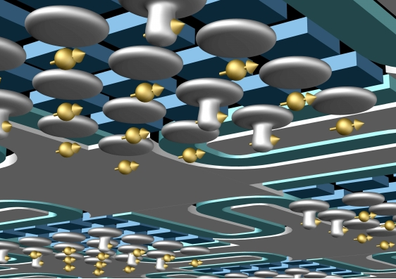
These electric dipoles interact with each other over fairly large distances, a good fraction of a micron, or 1,000 nanometres. “This means we can now place the single-atom qubits much further apart than previously thought possible.
So there is plenty of space to intersperse the key classical components such as interconnects, control electrodes and readout devices, while retaining the precise atom-like nature of the quantum bit.”

Slide 4
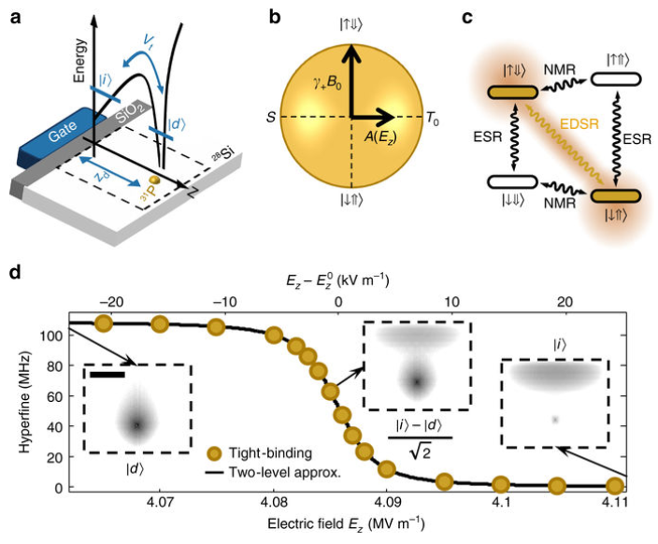
Coupling Si:P spin qubits to electric fields

Slide 5
Electrical Noise
Since the qubit operation is based upon the use of electric fields, a natural concern is the fragility of the qubit states in the presence of electric noise.There are special bias points that render the flip-flop qubit operation highly robust against noise.
So, a dispersive shift is used to stabilize the flip-flop precession frequency against noise. To quantify that, we assume a quasi-static electric field noise with 100 V m⁻¹ r.m.s. amplitude along the donor-dot direction This noise is equivalent to a 1.5 μeV charge detuning noise for d = 15 nm, consistent with experimentally observed values in similar silicon devices.

Slide 6
Relaxation
Another source of errors could come from relaxation via coupling to phonons. This is not an issue for bulk donors, where electron spin relaxation time is T_{1,s}≫1.
However, due to the particular valley composition of the flip-flop qubit near the ionization point, its relaxation rate 1/T_{1,ff} due to charge-phonon coupling is enhanced.
A possible solution is to displace the location of the interface wavefunction laterally, which in turn modifies the overlap between the donor and interface wavefunctions and therefore V_{t}.

Slide 7
Difference between a normal qubit and a flip-flop qubit is getting electron and nucleus to operate as single qubits using electric field instead of magnetic field.
The orbital wave function of the donor bound electron can be controlled by a vertical electric field.

Slide 8
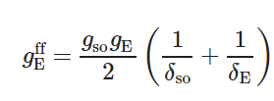
Electric drive of the flip-flop qubit
How do we achieve high-fidelity one-qubit x(y)-gates via electric drive of the flip-flop qubit.
The flip-flop qubit is still driven, via a second-order process, at a rate (half-Rabi frequency)

Slide 9

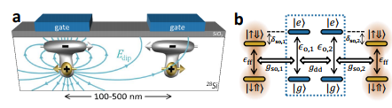
TWO-QUBIT COUPLING VIA ELECTRIC DIPOLE INTERACTION
This electric dipole-dipole interaction is therefore equivalent to a small shift in the equilibrium orbital position of both electrons plus a coupling term between the charge qubits
Most importantly, since each flip-flop qubit is coupled to their electron position (Eq. 5), the electric dipole-dipole interaction provides a natural way to couple two distant flip-flop qubits

Slide 10

The 2-qubit coupling rate is maximum when in resonance with a molecular state. However, this regime induces too many relaxation errors due to resonant charge excitation. Therefore it is best to detune the flip-flop qubits from the molecular states, while still keeping a substantial interqubit coupling rate via a second-order process, equal to:
2-qubit gates start with both electrons at the interface, where qubits are decoupled since the electric dipoles and the hyperfine interactions are first-order insensitive to vertical electric fields. Since gso vanishes and δso diverges. The electrons are then simultaneously and adiabatically displaced to the ionization point for a time necessary for an √ iSWAP gate, before returning to the interface.
The electron remains still for a short time before the whole process is then reversed. In the end a √ iSWAP gate is performed. With this we can eliminate relaxation errors.
Our proposed 2-qubit gates are not only highly protected against noise, but also robust against donor misplacement.

Slide 11
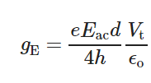
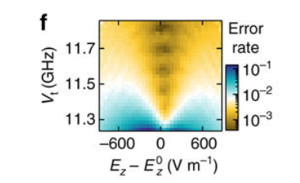
g_{E} is the driven electric coupling rate between the two charge eigenstates
Estimated flip-flop qubit π/2 x-gate error due to quasi-static noise with amplitude Enoisez,rms=100Ez,rmsnoise=100 V m⁻¹.

Slide 12
Scaling up using circuit quantum electrodynamics
How do we reach the long-term goal of a large-scale quantum processor given the high density in typical spin qubit architectures.
Recent solutions include cross-wiring using multilayer lithography or floating gate electrodes inspired by dynamic random access memory systems.

Slide 13
Conclusion
Superconducting qubits whereas flip flop silicon qubits.
Representing multiple states simultaneously.
Silicon king of Quantum Computing

